Slide 1

BBT-T-312, Oct.27th, 2015
Dry scrubber limestone filter new fc application report

Slide 2
Management Summary
Paint Shop Tiexi Plant 19.88
Time:
10 Min.
Date
2015-10-27
Topic:
Dry scrubber limestone filter new FC application report
Affected Products:
(please mark)
E84 | F35 | F30 | F45 | M13 | F49 | F49 PHEV | F52
X | X | X | X | X | X | X | X
Coordinated with
Additional participants
Mentor
Lecturer
Information
Li Bin, BBT-T-312
Lei Ming, BBT-T-312
X
Decision
Summary:
1. Situation
NT air filter is used for ASU and paint spray booth, can ensure the high quality for painting car. And mainly have about six type.
2. Task
The suppliers selected and evaluate potential qualify suppliers
Supplier quotation, test result and RFQ is OK. Currently, the lowest quotation (3500T) is from Dandong, and it is also the current supplier.
3. Action
For the normal temperature air filter, the budget of 2016 is ￥ 720T RMB (include 60U), and in 2014 and 2015, respectively is ￥494.12 and ￥492.45.
By extend the filter replacement cycle, increase from 1.5 months to 3 months, throughout the year of 2016 will save 78.4T RMB.
4. Result
Recommendation supplier is Dan Dong, Dan Dong has already accumulated more than two years experience on-site service in Tie Xi plant.
No quality problem, and no delivery delay.
Can actively cooperate with maintenance team and provide support.
The lowest quotation.
Information
BBT-T-3 circle acknowledges.
NT air filter new FC application report, BBT-T-312, ; 11st. Aug.2015
Page 2

Slide 3
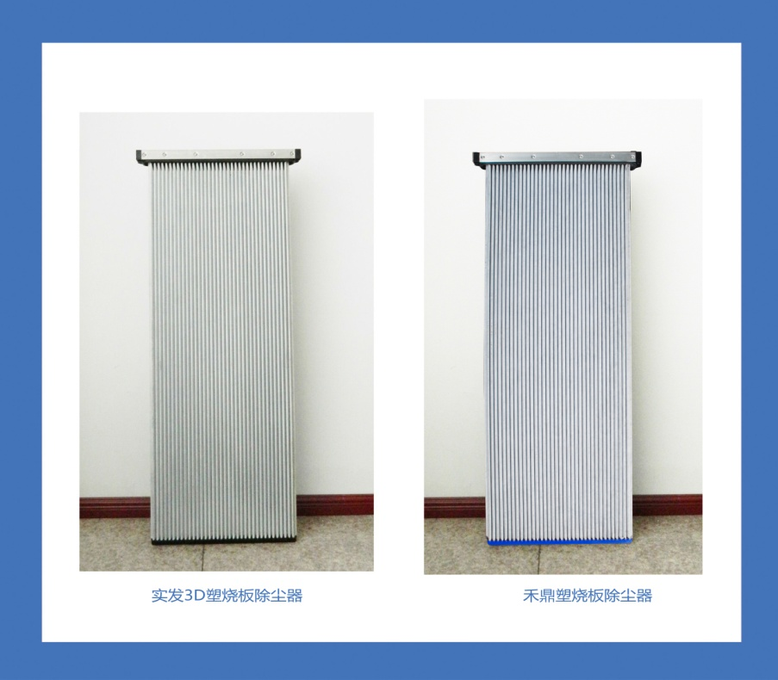
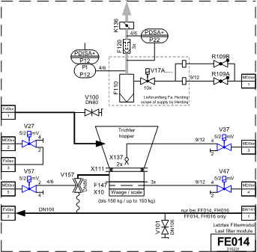
Dry scrubber limestone filter new fc application report
SITUATION
Filter element
Normal temperature air filter
No. | Type | Area | Period | Installation number
1 | U17 1500*500*50 | BC Section | 15000 hours | 800
2 | U17 1500*500*50 | CC Section | 15000 hours | 448

Slide 4
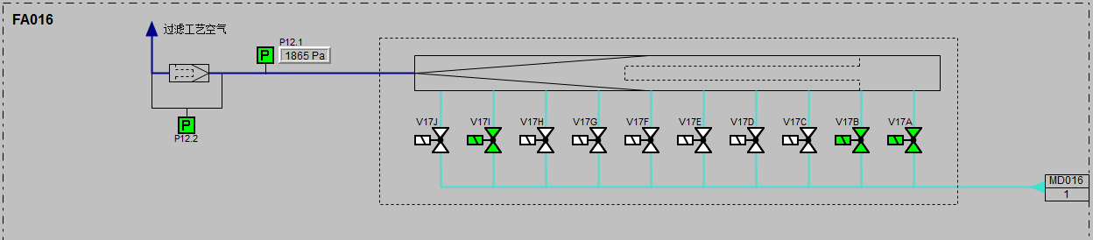
Dry scrubber limestone filter new fc application report
SITUATION
Dry scrubber limestone filter status:
The average differential pressure nearly 1900Pa in CC line, BC line nearly 1500Pa, and the limit value is 2500Pa.
The service time is close to 15,000 hours.
If the limestone filter block, it will influence pre-coat, fluidization, and dedust.
Currently, the limestone filter is from DURR. The unit price is 5000, and the installation number is 1248, totally cost 6,000T.

Slide 5
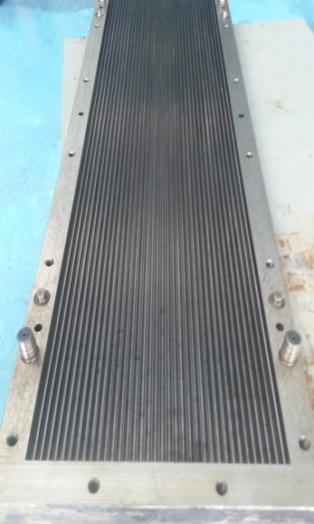
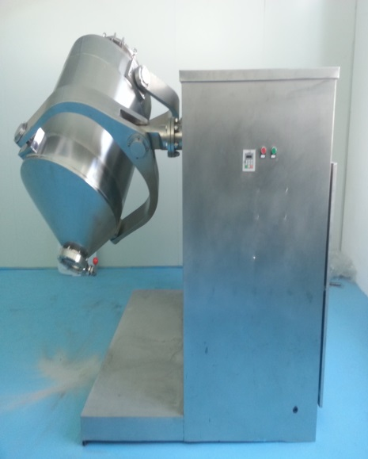
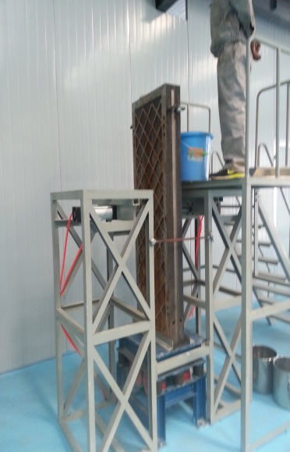
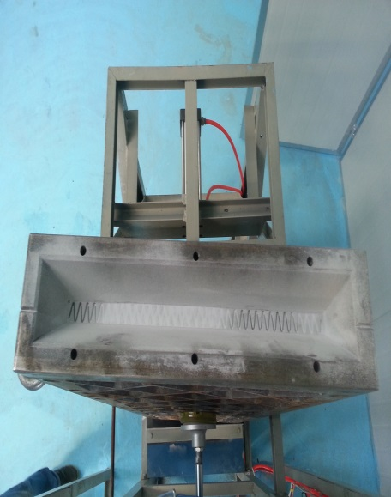
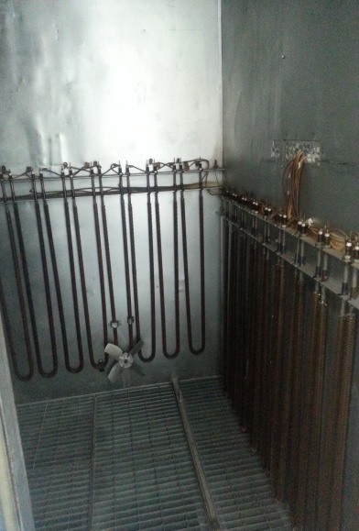
Dry scrubber limestone filter new fc application report
ACTION
Dry scrubber limestone filter production process:
Mould
Material mixed
Material filling
Vibration
High temperature burn

Slide 6
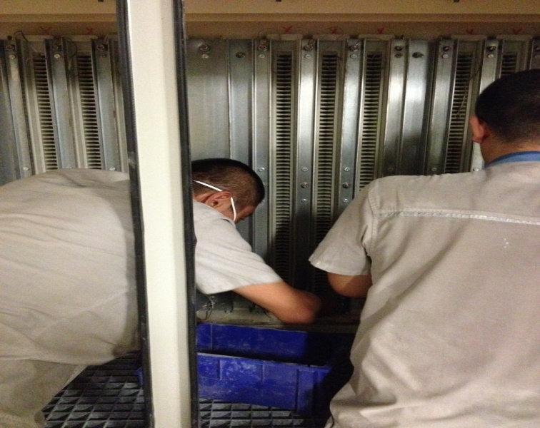
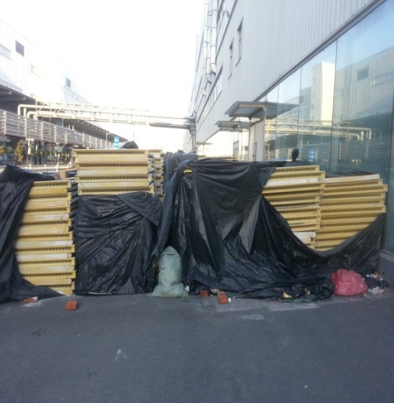
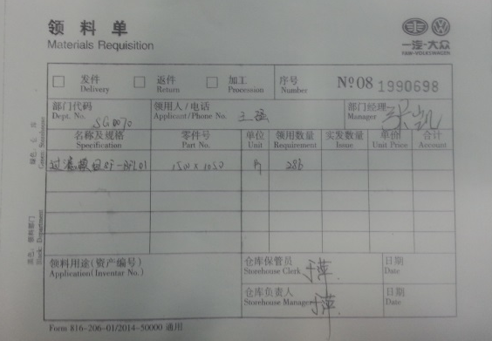
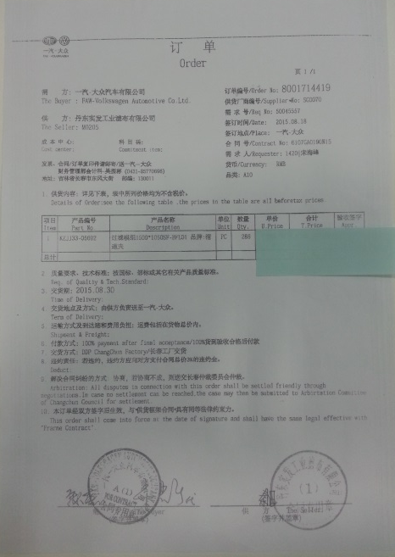
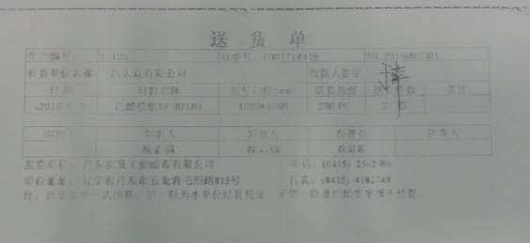
Dry scrubber limestone filter new fc application report
ACTION
Dry scrubber limestone filter production process:
FAW-VW dry scrubber limestone filter status:
The average differential pressure nearly 1800Pa in CC line, and then replace all of the CC line limestone filter.
Replacing date: Oct. 03rd, 2015.
Replace number: 286.
The service time is close to 15,000 hours.

Slide 7
NT air filter new fc application report
ACTON
参数对比
 | 项目/品牌 | 禾鼎 | 丹东实发3D
 | 型号 | HSL1500/18 | DD-3D PUREPACT 500
 | 尺寸 | 1500*500*50 | 1500*500*50
 | 滤膜材质 | PTFE-membrane,anti-static | PTFE-membrane,anti-static
 | 过滤等级 | U17@0.1um | U17@0.1um
 | 过滤面积 | 5.3m² | 5.5m²
 | 专利特性 | \ | 3D涂氟
 | 密封条 | 三元乙丙(EPDM)胶条 | 三元乙丙发泡/海绵条
注明:丹东实发3D的产品的褶数为37褶(左右各半条)，禾鼎的36褶，褶深也比禾鼎的稍深，所以过滤面积增加3%， 因此运行时阻力更低，使用寿命更长
采用浸涂、渗透聚四氟乙烯微粉水溶液技术，解决了原料配比和关键工艺技术条件参数的配合问题，发展了互溶性很差的聚四氟乙烯微粉牢固浸渗、粘接在基板外表面的工艺技术，使决定过滤精度及应用场合的技术瓶颈问题得到解决。
Weeks
K RMB
27%
83%
Period extend of filter, lead time from 24 weeks to 4 weeks, and save 83% once time
DURR need to ship from Germany to China
Dandong is near to Shen Yang.
Period extend of filter, Cost from 7310 T to 5366 T, and save 27% once time

Slide 8
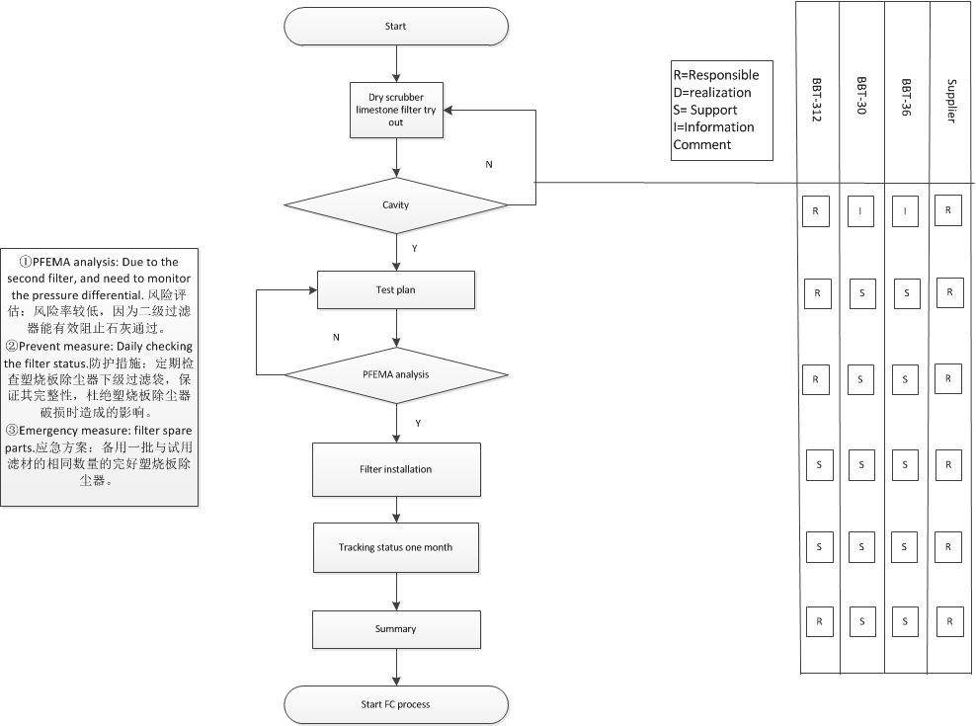
NT air filter new fc application report
ACTION

Slide 9
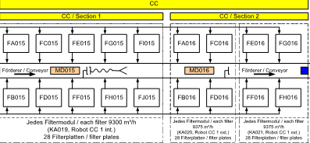
NT air filter new fc application report
ACTION
Filter Experimental area
Dry scrubber limestone filter test plan.
Position: CC ext FH016, we choose the harsh environment, cause of large volume over paint, it is benefit for test result. 试用位置：选择CC外喷位置，因为外喷漆量较大且较稠，有利于对塑烧板强度测试，以更直观方式发现差异，现确定在FH016位置试用。
Quantity: 32 unit U17 1500*500*50 limestone filter, and payment will take place after test successful. 试用数量：由丹东实发工业滤布有限公司提供32台型号为U17 1500*500*50 的塑烧板除尘器，如试用成功需要付款。
Test period: according to the experience of FAW-VW, 3 months. 试用周期：根据大众试用经验，采用三个月为试用周期。
Status tracking: 1) Pressure differential checking. three times per day. 2)Check the limestone filter installation and check the state of the secondary filter bag, handle in time when problems found. 1) 在车间生产时每日进行三次压差数值记录，分为早上5点记录一次，中午11：00记录一次，下午17：记录一次。2) 每日停产时开箱检查塑烧板状态，检查石灰过滤器状态，检查二级滤袋状态，发现问题及时处理。

Slide 10
NT air filter new fc application report
ACTION
BMW Brilliance Automotive Ltd 华晨宝马 汽车有限公司 |  | 生产期间压差 点检卡 _ BC干式文丘里FB011 |  |  |  |  |  |  |  |  |  |  |  |  |  |  |  |  |  |  |  |  |  |  |  |  |  |  |  | No: |  |  |  | R-151-WI-BBTT31-001
 |  |  |  |  |  |  |  |  |  |  |  |  |  |  |  |  |  |  |  |  |  |  |  |  |  |  |  |  |  | Issue Date: |  |  |  | 2014-05-30
 |  |  |  |  |  |  |  |  |  |  |  |  |  |  |  |  |  |  |  |  |  |  |  |  |  |  |  |  |  | Issue level: |  |  |  | 1
 |  |  |  |  |  |  |  |  |  |  |  |  |  |  |  |  |  |  |  |  |  |  |  |  |  |  |  |  |  | Page: |  |  |  | 60/63
NO. | Position 位置 | Contents 内容 | Method 方法 | Norm 标准 | 2015-09 |  |  |  |  |  |  |  |  |  |  |  |  |  |  | Date 日期 |  |  |  |  |  |  |  |  |  |  |  |  |  |  |  | Remark 备注
 |  |  |  |  | 1 | 2 | 3 | 4 | 5 | 6 | 7 | 8 | 9 | 10 | 11 | 12 | 13 | 14 | 15 | 16 | 17 | 18 | 19 | 20 | 21 | 22 | 23 | 24 | 25 | 26 | 27 | 28 | 29 | 30
1 | BC干式文丘里内喷FB011 | 日常压差点检 | value record 记录数值 | 5:00 AM
 |  | 日常压差点检 | value record 记录数值 | 11:00 AM
 |  | 日常压差点检 | value record 记录数值 | 4:00 PM
BMW Brilliance Automotive Ltd 华晨宝马 汽车有限公司 |  | 停产期间保全 点检卡 _ BC干式文丘里FB011 |  |  |  |  |  |  |  |  |  |  |  |  |  |  |  |  |  |  |  |  |  |  |  |  |  |  |  | No: |  |  |  | R-151-WI-BBTT31-001
 |  |  |  |  |  |  |  |  |  |  |  |  |  |  |  |  |  |  |  |  |  |  |  |  |  |  |  |  |  | Issue Date: |  |  |  | 2014-05-30
 |  |  |  |  |  |  |  |  |  |  |  |  |  |  |  |  |  |  |  |  |  |  |  |  |  |  |  |  |  | Issue level: |  |  |  | 1
 |  |  |  |  |  |  |  |  |  |  |  |  |  |  |  |  |  |  |  |  |  |  |  |  |  |  |  |  |  | Page: |  |  |  | 60/63
NO. | Position 位置 | Contents 内容 | Method 方法 | Norm 标准 | 2015-09 |  |  |  |  |  |  |  |  |  |  |  |  |  |  | Date 日期 |  |  |  |  |  |  |  |  |  |  |  |  |  |  |  | Remark 备注
 |  |  |  |  | 1 | 2 | 3 | 4 | 5 | 6 | 7 | 8 | 9 | 10 | 11 | 12 | 13 | 14 | 15 | 16 | 17 | 18 | 19 | 20 | 21 | 22 | 23 | 24 | 25 | 26 | 27 | 28 | 29 | 30
2 | BC干式文丘里内喷FB011 | 箱体内塑烧板除尘器状态检查 | 完好：√ 破损：× | 无石灰粉泄露，滤材外观状态良好
 |  | 二级滤袋完好无破损，袋内石灰粉较少 | 完好：√ 破损：× | 滤袋完好，无明显石灰
 |  | 检查废石灰漏斗，废石灰的多少 | 完好：√ 破损：× | 石灰收集槽石灰量与平时相比是否无异样

Slide 11
FC Status review
Status tracking
2015
CW44 | CW45 | CW46 | CW47 | CW48 | CW49 | CW50 | CW51 | CW52 | CW53 | CW54 | CW55
塑烧板除尘器试用
10.12第一阶段：塑孔实验
10.20第二阶段：实验方案
试用周期设定为一个月
试用地点设定为CC干式文丘里外喷FF016
10.27第三阶段：风险评估
11.15第四阶段：试用滤材安装
记录初始压差
11.16第五阶段：压差状态跟踪
每日三次压差记录及停产时检查滤材箱体内部状态
12.16第六阶段：试用期满一个月
总结试用报告
12.20第七阶段：启动提报流程

Slide 12
NT air filter new fc application report
RESULT
recommendation
Yearly consumption of 2016 is 720 T RMB.
Then 720T * 2 = 1440T RMB (Two years budget)
Basic principle:
After two years production practice, In order to ensure the stability of quality, we will adopt the fixed period. And Da Dong plant is also using this way.
We want make backup supplier strategy to avoid the Paint Shop quality dropped when the FC contractor product have problems.
To ensure the stability and continuity of the process.
In order to fully use the framework contract and efficient work, the frame contract will include NEX new plant.
K RMB
Recommendation supplier: 丹东实发工业滤布有限公司
Dan Dong has already accumulated more than two years experience on-site service in Tie Xi plant.
No quality problem, and no delivery delay during the past two years.
Can actively cooperate with maintenance team and provide support.
The lowest quotation.

Slide 13
Thanks for your attention.

Slide 14
NT air filter new fc application report
Backup document

Slide 15
NT air filter new fc application report
SITUATION

Slide 16
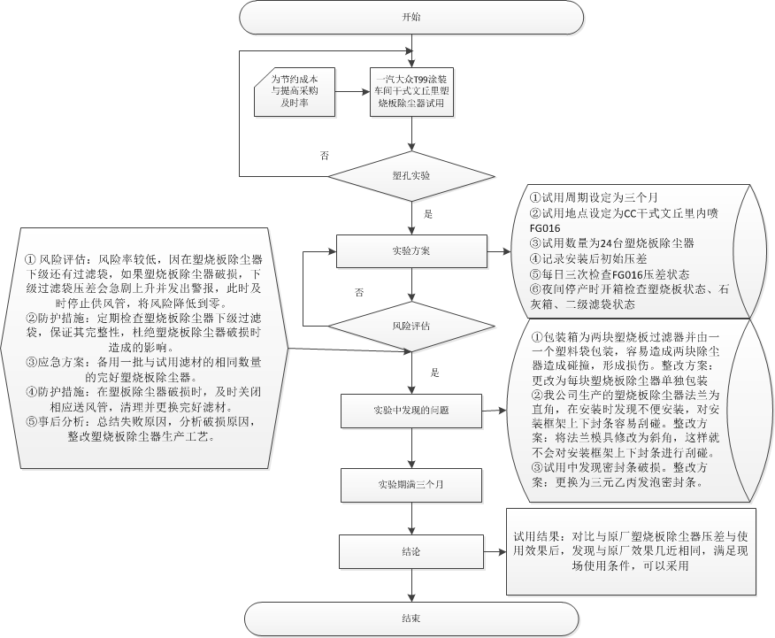
NT air filter new fc application report
SITUATION

